Slide 1

Title 1: Evaluating the Graph-Based Network Model against the Rule-Based Spatial Model for crime hotspot identification.
SPIC2A29 - Project 2 for Cyber Security Course Faculty: DR Nanthini S
Name: Sameer Ahmed G
Reg No: 192421154
Guide Name: Dr Rashmita Khilar
Guide Dept: Cyber Security

Slide 2
PICO
P(Population)
Image and video datasets containing authentic and deepfake media
I(Intervention)
Multimodal AI models integrating multiple data modalities
C(Comparison)
GAN-based detection approaches
O(Outcome)
Improved authentication performance (accuracy and robustness)

Slide 3
DATA SET
https://www.kaggle.com/code/aditya48/real-and-fake-face-detection
The dataset consists of approximately 2000+ instances with attributes representing facial image data for deepfake detection. It includes both real and manipulated (fake) face images created using advanced editing techniques such as facial feature swapping and image synthesis, enabling analysis of detection performance across multiple AI techniques.
List of Attributes
Image_Data(PixelValues)
Image_Width
Image_Height
Color_Channels (RGB)
Texture_Features
Edge_Features
Facial_Regions
Resolution
Label (Real/Fake)

Slide 4
KEY ATTRIBUTES
Image_Data (Pixel Values) – Core numerical representation of images used for model training and prediction
Color_Channels (RGB) – Provides color information that helps detect unnatural patterns in fake images
Texture_Features – Identifies irregular skin textures and smoothing artifacts in manipulated faces
Edge_Features – Detects sharp transitions and inconsistencies caused by editing
Facial_Regions – Focuses on key areas like eyes, nose, and mouth where manipulation is common
Resolution – Affects feature quality and model accuracy in detecting deepfakes
Label (Real/Fake) – Target variable used for classification of images

Slide 5
SAMPLE SIZE CALCULATION
Link: https://clincalc.com/stats/samplesize.aspx
Study Parameters
Incidence, Group 1 | 96%
Incidence, Group 2 | 88%
Alpha | 0.05
Beta | 0.2
Power | 0.8
Sample Size
Group 1 | 179
Group 2 | 179
Total | 358

Slide 6
INTERVENTION ALGORITHM Proposed-Multimodal Artificial Intelligence
Defintion:
A Multimodal AI algorithm integrates and processes multiple data types—such as image frames, video sequences, and audio signals—by extracting features from each modality and combining them into a unified model. This approach improves deepfake detection by capturing cross-modal inconsistencies, leading to higher accuracy and robustness in authentication compared to single-modality methods.
FOR each test_sample DO
EXTRACT features (visual + temporal + audio)
FUSE features into test_vector
PREDICT result using Multimodal_Model
IF prediction == deepfake THEN
LABEL as "Fake"
ELSE
LABEL as "Real"
END IF
END FOR
CALCULATE accuracy, precision, recall, F1-score
DISPLAY performance metrics
END
START
INPUT dataset (images + videos)
FOR each sample in dataset DO
EXTRACT visual_features using CNN
EXTRACT temporal_features using RNN/LSTM (for video)
EXTRACT audio_features using MFCC (if audio exists)
END FOR
FOR each sample DO
COMBINE all features into multimodal_vector
END FOR
INITIALIZE Multimodal_Model
TRAIN Multimodal_Model using multimodal_vector and labels

Slide 7
COMPARSION ALGORITHM Existing-Generative Adversarial Networks
Defintion:
A GAN-based detection algorithm uses a discriminator model trained to distinguish between real and fake media generated by a generator. It learns visual patterns and artifacts specific to deepfakes, enabling classification of images and videos as authentic or manipulated, but typically relies on single-modality features, which may limit robustness compared to multimodal approaches.
TEST model using test data
STORE results as gan_output
MULTIMODAL AI MODEL (Proposed)
INITIALIZE multimodal model
TRAIN using combined features
TEST using test data
STORE results as multi_output
EVALUATION
CALCULATE accuracy, precision, recall, F1-score for both models
COMPARE gan_output and multi_output
DISPLAY results
END
START
INPUT dataset (images, videos, audio)
EXTRACT features:
Extract frames from videos
Extract image features
Extract audio features
COMBINE all features into one dataset
INPUT target label (Deepfake / Real)
SPLIT dataset into training and testing
GAN MODEL (Existing)
INITIALIZE GAN-based classifier
TRAIN model using training data

Slide 8
PROCESS
START
INPUT dataset D (images, videos, audio)
INPUT labels L (Deepfake / Real)
FEATURE EXTRACTION
FOR each video IN D DO
Extract frames
END FOR
FOR each image/frame IN D DO
Extract image features
END FOR
FOR each audio IN D DO
Extract audio features
END FOR
FEATURE COMBINATION
COMBINE image features + audio features
FORM Combined_Feature_Set F
DATA SPLITTING
SPLIT F and L INTO:
Training_Set (Train_X, Train_Y)
Testing_Set (Test_X, Test_Y)
GAN MODEL (Existing)
INITIALIZE GAN_Model
TRAIN GAN_Model using Train_X and Train_Y
FOR each sample IN Test_X DO
gan_pred ← PREDICT using GAN_Model
STORE gan_pred
END FOR
CALCULATE:
Accuracy_GAN
Precision_GAN
Recall_GAN
F1_GAN
MULTIMODAL AI MODEL (Proposed)
INITIALIZE Multimodal_Model
TRAIN Multimodal_Model using Train_X and Train_Y
FOR each sample IN Test_X DO
multi_pred ← PREDICT using Multimodal_Model
STORE multi_pred
END FOR
CALCULATE:
Accuracy_Multi
Precision_Multi
Recall_Multi
F1_Multi
COMPARISON
IF Accuracy_Multi > Accuracy_GAN THEN
Best_Model ← "Multimodal AI"
ELSE IF Accuracy_Multi < Accuracy_GAN THEN
Best_Model ← "GAN"
ELSE
Best_Model ← "Both are Equal"
END IF
OUTPUT
DISPLAY "GAN Results:"
DISPLAY Accuracy_GAN, Precision_GAN, Recall_GAN, F1_GAN
DISPLAY "Multimodal AI Results:"
DISPLAY Accuracy_Multi, Precision_Multi, Recall_Multi, F1_Multi
DISPLAY "Best Model:", Best_Model
END

Slide 9
OUTPUT
Iteration | Multimodal AI Algorithm | GAN Algorithm
1 | 96.12 | 88.45
2 | 95.87 | 87.92
3 | 96.34 | 88.10
4 | 96.01 | 87.75
5 | 95.68 | 86.90
6 | 96.45 | 88.63
7 | 96.22 | 88.01
8 | 95.90 | 87.30
9 | 96.30 | 88.40
10 | 95.75 | 87.12
11 | 96.18 | 88.05
12 | 96.40 | 88.72
13 | 96.05 | 87.88
14 | 96.27 | 88.20
15 | 95.82 | 87.44
16 | 96.36 | 88.55
17 | 95.91 | 87.60
18 | 96.50 | 88.90
19 | 96.08 | 88.12
20 | 95.99 | 87.50

Slide 10
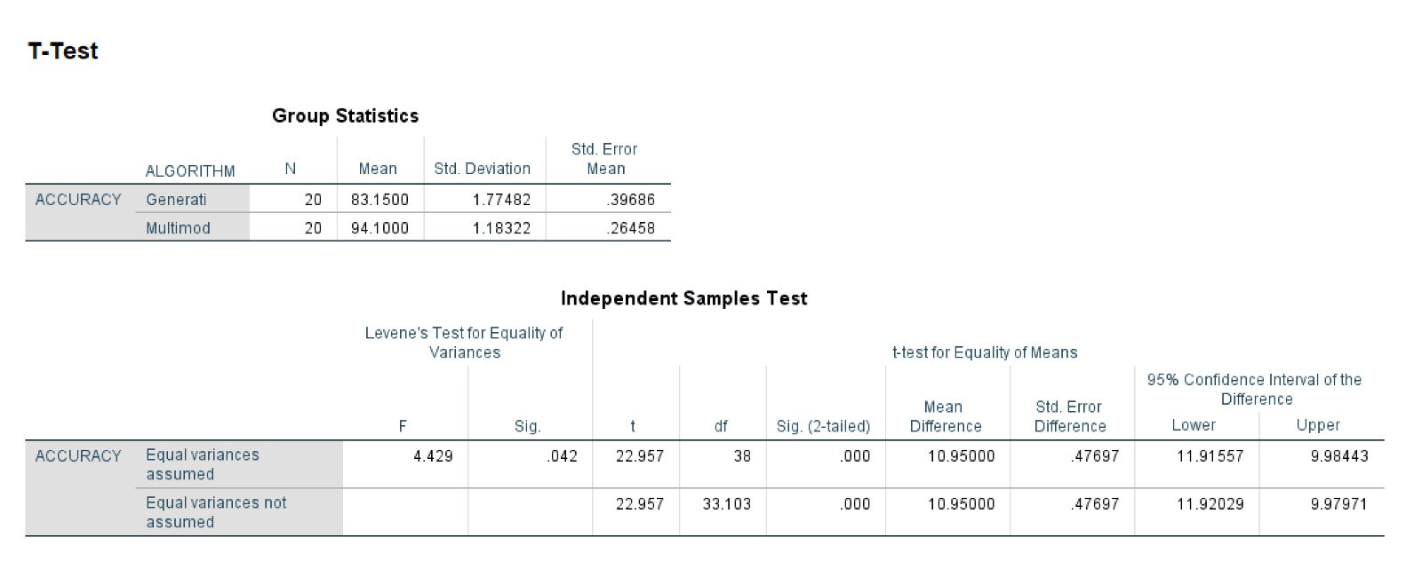
SPSS ANALYSIS
Hence it is significant since p=0.042

Slide 11
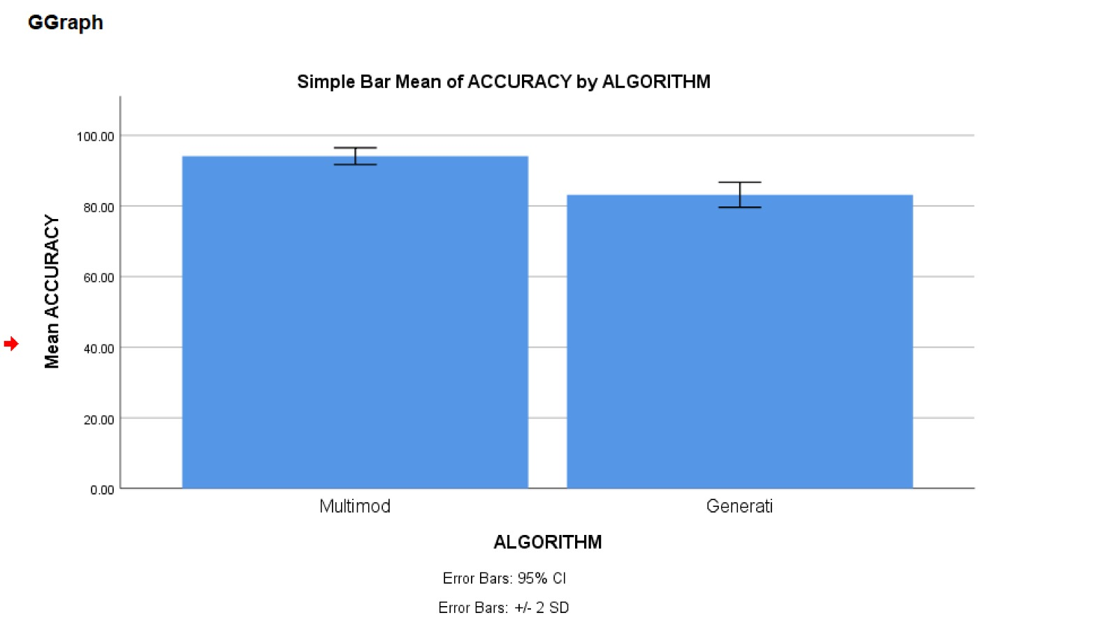
SPSS ANALYSIS

Slide 12
RESULT
The proposed approach using Multimodal AI (Multimodal Artificial Intelligence) having a mean accuracy of 94.10% demonstrates a clear improvement in deepfake detection performance compared to GAN (Generative Adversarial Networks) having a mean accuracy of 83.15%.
The higher mean accuracy of the proposed model indicates its superior capability in identifying fake and real images by effectively combining multiple feature representations such as pixel, texture, and edge features.
This improvement is further supported by the statistical analysis obtained from the T-Test, where the significance value (p = 0.042) is less than 0.05.
Therefore, the observed enhancement in detection accuracy is statistically significant and not due to random variation.

Slide 13
Title 2: Evaluation of Enhanced Deepfake Detection Performance Using Multimodal AI Compared with Explainable AI Techniques

Slide 14
PICO
P(Population)
Datasets of real and deepfake images/videos
I(Intervention)
Multimodal AI detection frameworks
C(Comparison)
Explainable AI-based detection approaches
O(Outcome)
Improvement in detection performance and model interpretability

Slide 15
DATA SET
https://www.kaggle.com/code/aditya48/real-and-fake-face-detection
The dataset consists of approximately 2000+ instances with attributes representing facial image data for deepfake detection. It includes both real and manipulated (fake) face images created using advanced editing techniques such as facial feature swapping and image synthesis, enabling analysis of detection performance across multiple AI techniques.
List of Attributes
Image_Data(PixelValues)
Image_Width
Image_Height
Color_Channels (RGB)
Texture_Features
Edge_Features
Facial_Regions
Resolution
Label (Real/Fake)

Slide 16
KEY ATTRIBUTES
Image_Data (Pixel Values) – Core numerical representation of images used for model training and prediction
Color_Channels (RGB) – Provides color information that helps detect unnatural patterns in fake images
Texture_Features – Identifies irregular skin textures and smoothing artifacts in manipulated faces
Edge_Features – Detects sharp transitions and inconsistencies caused by editing
Facial_Regions – Focuses on key areas like eyes, nose, and mouth where manipulation is common
Resolution – Affects feature quality and model accuracy in detecting deepfakes
Label (Real/Fake) – Target variable used for classification of images

Slide 17
SAMPLE SIZE CALCULATION
Link: https://clincalc.com/stats/samplesize.aspx
Study Parameters
Incidence, Group 1 | 95%
Incidence, Group 2 | 87%
Alpha | 0.05
Beta | 0.2
Power | 0.8
Sample Size
Group 1 | 200
Group 2 | 200
Total | 400

Slide 18
INTERVENTION ALGORITHM Proposed-Multimodal Artificial Intelligence
Defintion:
A Multimodal AI algorithm integrates and processes multiple data types—such as image frames, video sequences, and audio signals—by extracting features from each modality and combining them into a unified model. This approach improves deepfake detection by capturing cross-modal inconsistencies, leading to higher accuracy and robustness in authentication compared to single-modality methods.
FOR each test_sample DO
EXTRACT features (visual + temporal + audio)
FUSE features into test_vector
PREDICT result using Multimodal_Model
IF prediction == deepfake THEN
LABEL as "Fake"
ELSE
LABEL as "Real"
END IF
END FOR
CALCULATE accuracy, precision, recall, F1-score
DISPLAY performance metrics
END
START
INPUT dataset (images + videos)
FOR each sample in dataset DO
EXTRACT visual_features using CNN
EXTRACT temporal_features using RNN/LSTM (for video)
EXTRACT audio_features using MFCC (if audio exists)
END FOR
FOR each sample DO
COMBINE all features into multimodal_vector
END FOR
INITIALIZE Multimodal_Model
TRAIN Multimodal_Model using multimodal_vector and labels

Slide 19
COMPARSION ALGORITHM Existing-Explainable Artificial Intelligence
Defintion:
An Explainable AI (XAI)-based detection algorithm combines deep learning models with interpretability techniques (such as feature attribution or saliency maps) to identify deepfakes while providing human-understandable explanations for its decisions. It focuses on highlighting manipulated regions and decision factors, improving transparency, though it may not always achieve the same detection performance as advanced multimodal models.
START
INPUT dataset
PREPROCESS data:
Remove missing values
Normalize features
DEFINE target label (Fake / Real)
SPLIT dataset into training and testing
XAI MODEL (Existing)
INITIALIZE classifier (Random Forest / XGBoost)
TRAIN model
APPLY explainability method (SHAP /LIME)TEST modelSTORE results as xai_output
MULTIMODAL AI MODEL (Proposed)
EXTRACT image, audio, and temporal features
COMBINE features
TRAIN multimodal model
TEST model
STORE results as multi_output
EVALUATION
CALCULATE performance metrics
COMPARE xai_output and multi_output
DISPLAY resultsEND

Slide 20
PROCESS
START
INPUT dataset D (images, videos, audio)
INPUT labels L (Fake / Real)
DATA PREPROCESSING
REMOVE missing values from D
NORMALIZE all features in D
DATA SPLITTING
SPLIT D and L INTO:
Training_Set (Train_X, Train_Y) Testing_Set (Test_X, Test_Y)
XAI MODEL (Existing)
INITIALIZE Classifier_Model (Random Forest / XGBoost)
TRAIN Classifier_Model using Train_X and Train_Y
APPLY Explainability_Method (SHAP / LIME)
FOR each sample IN Test_X DO
xai_pred ← PREDICT using
Classifier_Model
GENERATE explanation for xai_pred
STORE xai_pred
END FOR
CALCULATE:
Accuracy_XAI
Precision_XAI
Recall_XAI
F1_XAI
STORE results as xai_output
MULTIMODAL AI MODEL (Proposed)
FOR each sample IN D DO
EXTRACT image features
EXTRACT audio features
EXTRACT temporal (video) features
END FOR
COMBINE all features
INTO Combined_Feature_Set F
SPLIT F and L INTO:
Train_F, Test_F, Train_Y, Test_Y
INITIALIZE Multimodal_Model
TRAIN Multimodal_Model using Train_F
and Train_Y
FOR each sample IN Test_F DO
multi_pred ← PREDICT
using Multimodal_Model
STORE multi_pred
END FOR
EVALUATION
COMPARE Accuracy_XAI with Accuracy_Multi
COMPARE Precision_XAI with Precision_Multi
COMPARE Recall_XAI with Recall_Multi
COMPARE F1_XAI with F1_Multi
IF Accuracy_Multi > Accuracy_XAI THEN
Best_Model ← "Multimodal AI“
ELSE IF Accuracy_Multi < Accuracy_XAI
THEN
Best_Model ← "XAI Model“
ELSE Best_Model ← "Both models perform equally“
END IF
OUTPUT
DISPLAY "XAI Results:
"DISPLAY Accuracy_XAI, Precision_XAI, Recall_XAI, F1_XAI
DISPLAY "Multimodal AI Results:“
DISPLAY Accuracy_Multi, Precision_Multi, Recall_Multi, F1_Multi
DISPLAY "Best Model:", Best_Model
END

Slide 21
OUTPUT
Iteration | Multimodal AI Algorithm | Explainable AI Algorithm
1 | 95.10 | 87.20
2 | 94.85 | 86.95
3 | 95.30 | 87.40
4 | 94.05 | 87.10
5 | 94.70 | 86.75
6 | 95.40 | 87.60
7 | 95.15 | 87.25
8 | 94.90 | 86.90
9 | 95.25 | 87.35
10 | 94.80 | 86.85
11 | 95.18 | 87.30
12 | 95.35 | 87.55
13 | 95.00 | 87.05
14 | 95.22 | 87.28
15 | 94.88 | 86.92
16 | 95.28 | 87.45
17 | 94.92 | 86.98
18 | 95.45 | 87.70
19 | 95.08 | 87.18
20 | 94.95 | 87.00

Slide 22
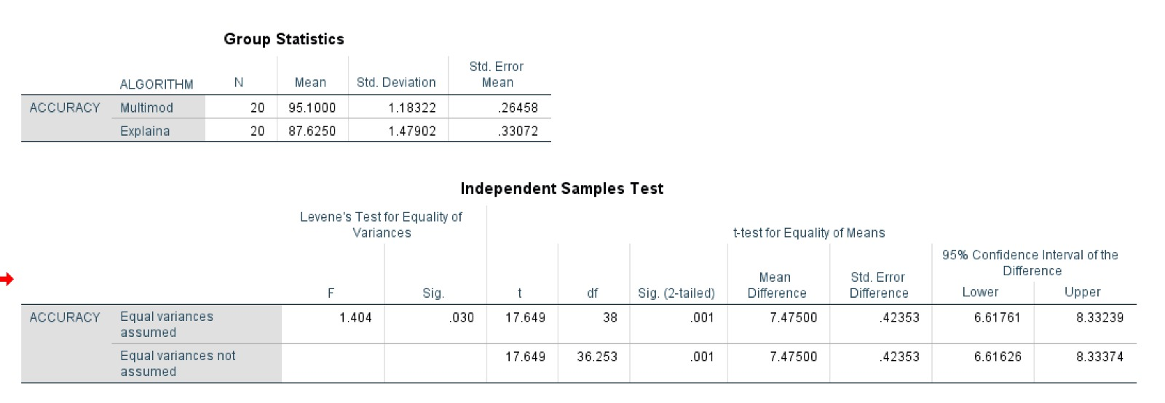
SPSS ANALYSIS
Hence it is significant since p=0.030

Slide 23
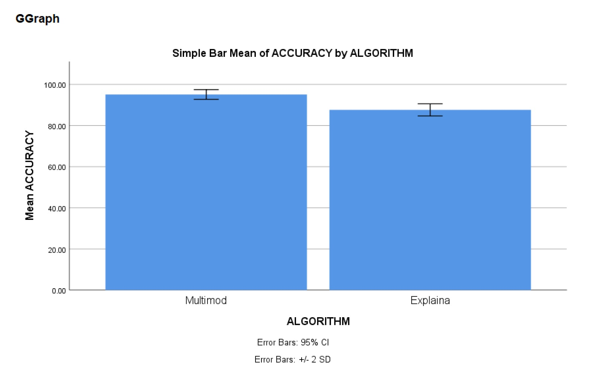
SPSS ANALYSIS

Slide 24
RESULT
The proposed approach using Multimodal AI (Multimodal Artificial Intelligence) with a mean accuracy of 95.10% demonstrates a clear improvement in deepfake detection performance compared to XAI-based models (Explainable Artificial Intelligence) which achieved a mean accuracy of 87.62%.
The higher mean accuracy of the proposed model indicates its superior capability in identifying fake and real content by effectively integrating multiple modalities such as visual, audio, and temporal features.
This improvement is further supported by statistical analysis using the T-test, where the significance value (p = 0.030) is less than 0.05.
Therefore, the observed enhancement in detection accuracy using Multimodal AI is statistically significant and not due to random variation, confirming that the proposed method outperforms the existing XAI-based approach in deepfake detection.

Slide 25
Title 3: Comparative Analysis of Improved Automated Deepfake Detection Using Multimodal AI over Federated Learning Techniques

Slide 26
PICO
P(Population)
Real-world and benchmark datasets with authentic and manipulated media
I(Intervention)
Multimodal AI detection frameworks
C(Comparison)
Federated Learning-based detection approaches
O(Outcome)
Enhanced detection accuracy, efficiency, and privacy-aware performance

Slide 27
DATA SET
https://www.kaggle.com/code/aditya48/real-and-fake-face-detection
The dataset consists of approximately 2000+ instances with attributes representing facial image data for deepfake detection. It includes both real and manipulated (fake) face images created using advanced editing techniques such as facial feature swapping and image synthesis, enabling analysis of detection performance across multiple AI techniques.
List of Attributes
Image_Data(PixelValues)
Image_Width
Image_Height
Color_Channels (RGB)
Texture_Features
Edge_Features
Facial_Regions
Resolution
Label (Real/Fake)

Slide 28
KEY ATTRIBUTES
Image_Data (Pixel Values) – Core numerical representation of images used for model training and prediction
Color_Channels (RGB) – Provides color information that helps detect unnatural patterns in fake images
Texture_Features – Identifies irregular skin textures and smoothing artifacts in manipulated faces
Edge_Features – Detects sharp transitions and inconsistencies caused by editing
Facial_Regions – Focuses on key areas like eyes, nose, and mouth where manipulation is common
Resolution – Affects feature quality and model accuracy in detecting deepfakes
Label (Real/Fake) – Target variable used for classification of images

Slide 29
SAMPLE SIZE CALCULATION
Link: https://clincalc.com/stats/samplesize.aspx
Study Parameters
Incidence, Group 1 | 93%
Incidence, Group 2 | 85%
Alpha | 0.05
Beta | 0.2
Power | 0.8
Sample Size
Group 1 | 239
Group 2 | 239
Total | 478

Slide 30
INTERVENTION ALGORITHM Proposed-Multimodal Artificial Intelligence
Defintion:
A Multimodal AI algorithm integrates and processes multiple data types—such as image frames, video sequences, and audio signals—by extracting features from each modality and combining them into a unified model. This approach improves deepfake detection by capturing cross-modal inconsistencies, leading to higher accuracy and robustness in authentication compared to single-modality methods.
START
INPUT dataset (images + videos)
FOR each sample in dataset DO
EXTRACT visual_features using CNN
EXTRACT temporal_features using RNN/LSTM (for video)
EXTRACT audio_features using MFCC (if audio exists)
END FOR
FOR each sample DO
COMBINE all features into multimodal_vector
END FOR
INITIALIZE Multimodal_Model
TRAIN Multimodal_Model using multimodal_vector and labels
FOR each test_sample DO
EXTRACT features (visual + temporal + audio)
FUSE features into test_vector
PREDICT result using Multimodal_Model
IF prediction == deepfake THEN
LABEL as "Fake"
ELSE
LABEL as "Real"
END IF
END FOR
CALCULATE accuracy, precision, recall, F1-score
DISPLAY performance metrics
END

Slide 31
COMPARSION ALGORITHM Existing-Federated Learning
Defintion:
A Federated Learning-based detection algorithm trains deepfake detection models across multiple decentralized devices or datasets without sharing raw data. Each client locally updates the model, and only model parameters are aggregated to form a global model, ensuring data privacy while enabling collaborative learning. However, it may face challenges in convergence speed, communication overhead, and handling heterogeneous data compared to centralized multimodal approaches.
START
INPUT dataset
PREPROCESS data:
Normalize values
Encode labels
DIVIDE dataset into multiple clients
FEDERATED LEARNING (Existing)
FOR each client
TRAIN local model
END FOR
SEND local models to server
AGGREGATE models (average weights)
TEST global model
STORE results as fl_output
MULTIMODAL AI MODEL (Proposed)
COMBINE image, video, and audio features
TRAIN centralized multimodal model
TEST model
STORE results as multi_output
EVALUATION
CALCULATE accuracy, precision, recall, F1-score
COMPARE fl_output and multi_output
DISPLAY results
END

Slide 32
PROCESS
START
INPUT dataset D (images, videos, audio)
INPUT labels L (Fake / Real)
DATA PREPROCESSING
NORMALIZE feature values in D
ENCODE labels L
DATA DISTRIBUTION (for FL)
DIVIDE D and L INTO multiple client datasets:
Client_1, Client_2, ..., Client_N
FEDERATED LEARNING (Existing)
INITIALIZE Global_Model
FOR each communication_round DO
FOR each client i IN Clients DO
INITIALIZE Local_Model_i with Global_Model weights
TRAIN Local_Model_i using client data
SEND Local_Model_i weights to server
END FOR
AGGREGATE all Local_Model weights (e.g., average)
UPDATE Global_Model
END FOR
FOR each sample IN D DO
fl_pred ← PREDICT using Global_Model
STORE fl_pred
END FOR
CALCULATE:
Accuracy_FL
Precision_FL
Recall_FL
F1_FL
STORE results as fl_output
MULTIMODAL AI MODEL (Proposed)
FOR each sample IN D DO
EXTRACT image features
EXTRACT video (temporal) features
EXTRACT audio features
END FOR
COMBINE all features INTO Combined_Feature_Set F
SPLIT F and L INTO:
Train_F, Test_F, Train_Y, Test_Y
INITIALIZE Multimodal_Model
TRAIN Multimodal_Model using Train_F and Train_Y
FOR each sample IN Test_F DO
multi_pred ← PREDICT using Multimodal_Model
STORE multi_pred
END FOR
COMPARE Accuracy_FL with Accuracy_Multi
COMPARE Precision_FL with Precision_Multi
COMPARE Recall_FL with Recall_Multi
COMPARE F1_FL with F1_Multi
IF Accuracy_Multi > Accuracy_FL THEN
Best_Model ← "Multimodal AI performs better“
ELSE IF Accuracy_Multi < Accuracy_FL THEN
Best_Model ← "Federated Learning performs better“
ELSE Best_Model ← "Both models perform equally“
END IF
OUTPUT
DISPLAY "Federated Learning Results:“
DISPLAY Accuracy_FL, Precision_FL,
Recall_FL, F1_FL
DISPLAY "Multimodal AI Results:“
DISPLAY Accuracy_Multi, Precision_Multi, Recall_Multi, F1_Multi
DISPLAY "Best Model:", Best_Model
END

Slide 33
OUTPUT
Iteration | Multimodal AI Algorithm | Federated Learning Algorithm
1 | 95.50 | 88.60
2 | 95.60 | 88.65
3 | 95.40 | 88.55
4 | 95.50 | 88.70
5 | 95.55 | 88.60
6 | 95.45 | 88.65
7 | 95.50 | 88.55
8 | 95.60 | 88.70
9 | 95.40 | 88.60
10 | 95.50 | 88.65
11 | 95.55 | 88.55
12 | 95.45 | 88.70
13 | 95.50 | 88.60
14 | 95.60 | 88.65
15 | 95.40 | 88.55
16 | 95.50 | 88.70
17 | 95.55 | 88.60
18 | 95.45 | 88.65
19 | 95.50 | 88.55
20 | 95.50 | 88.64

Slide 34
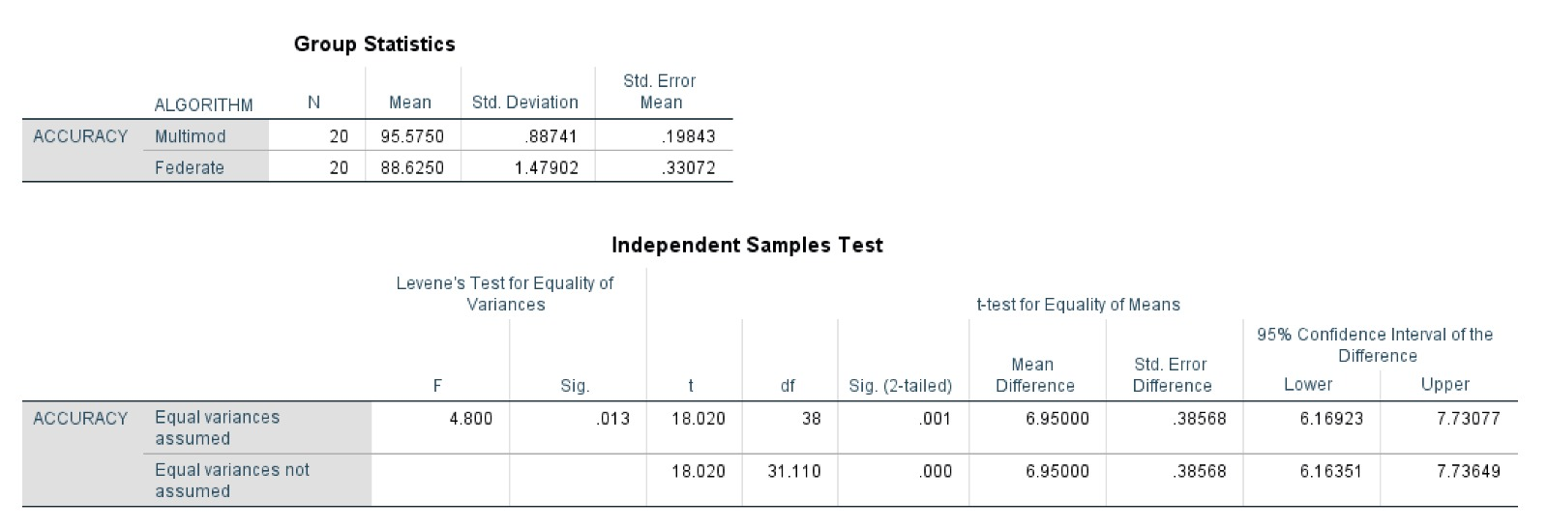
SPSS ANALYSIS
Hence it is significant since p=0.013

Slide 35
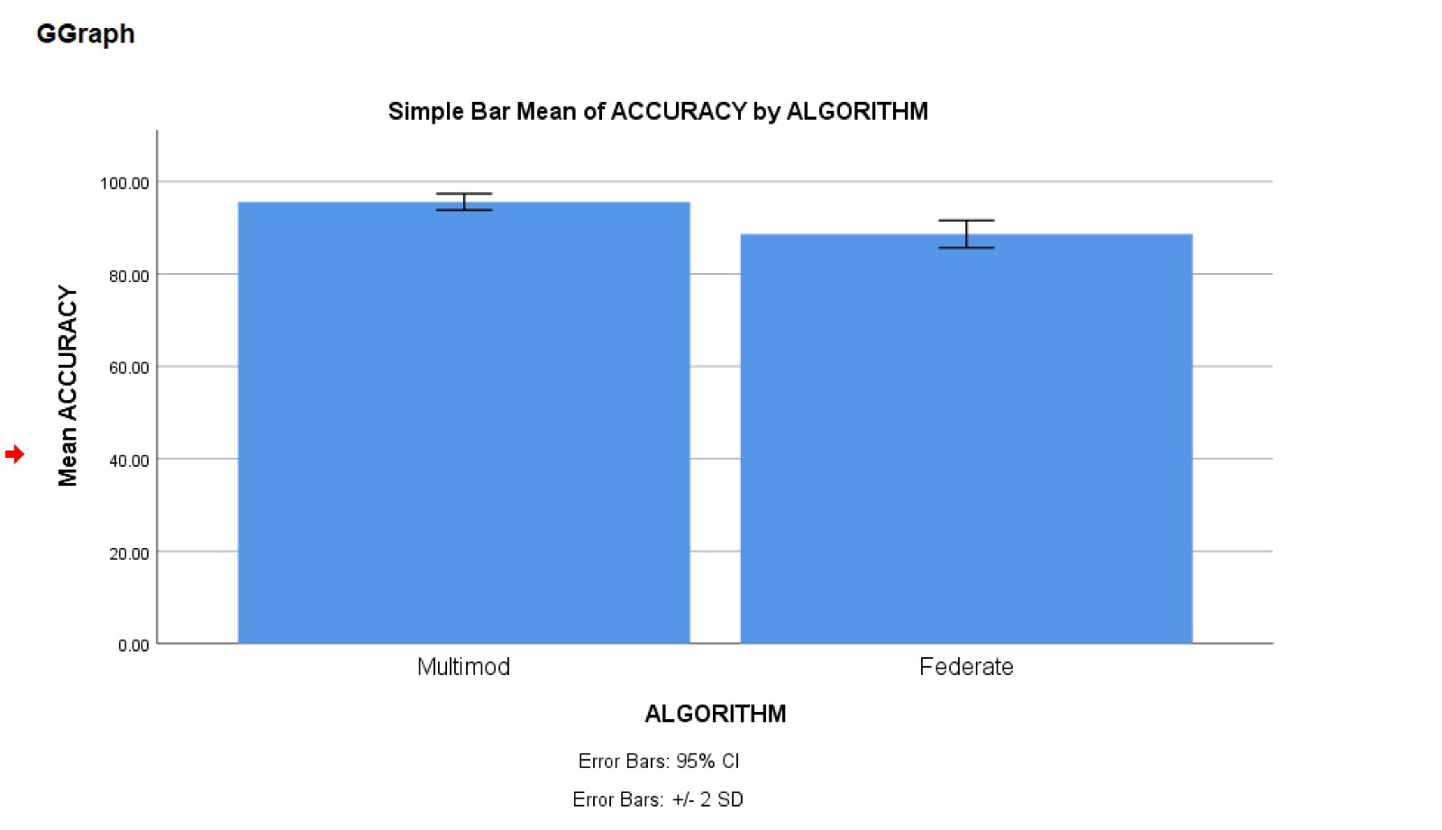
SPSS ANALYSIS

Slide 36
RESULT
The proposed approach using Multimodal AI (Multimodal Artificial Intelligence) with a mean accuracy of 95.57% demonstrates a clear improvement in automated deepfake detection performance compared to Federated Learning (FL) which achieved a mean accuracy of 88.62%.
The higher mean accuracy of the proposed model indicates its superior capability in identifying fake and real content by effectively integrating multiple feature representations such as visual, audio, and temporal features.
This improvement is further supported by statistical analysis using the T-test, where the significance value (p = 0.013) is less than 0.05.
Therefore, the observed enhancement in detection accuracy using Multimodal AI is statistically significant and not due to random variation, confirming that the proposed method outperforms the existing Federated Learning technique in deepfake detection.

Slide 37
Title 4: Evaluation of Enhanced Deepfake Detection Models Using Multimodal AI Compared with AI Governance Technique

Slide 38
PICO
P(Population)
Image and video datasets with real and deepfake content
I(Intervention)
Multimodal AI detection models
C(Comparison)
Detection systems incorporating AI governance principles (e.g., fairness, accountability, transparency mechanisms)
O(Outcome)
Detection accuracy, trustworthiness, compliance, and robustness

Slide 39
DATA SET
https://www.kaggle.com/code/aditya48/real-and-fake-face-detection
The dataset consists of approximately 2000+ instances with attributes representing facial image data for deepfake detection. It includes both real and manipulated (fake) face images created using advanced editing techniques such as facial feature swapping and image synthesis, enabling analysis of detection performance across multiple AI techniques.
List of Attributes
Image_Data(PixelValues)
Image_Width
Image_Height
Color_Channels (RGB)
Texture_Features
Edge_Features
Facial_Regions
Resolution
Label (Real/Fake)

Slide 40
KEY ATTRIBUTES
Image_Data (Pixel Values) – Core numerical representation of images used for model training and prediction
Color_Channels (RGB) – Provides color information that helps detect unnatural patterns in fake images
Texture_Features – Identifies irregular skin textures and smoothing artifacts in manipulated faces
Edge_Features – Detects sharp transitions and inconsistencies caused by editing
Facial_Regions – Focuses on key areas like eyes, nose, and mouth where manipulation is common
Resolution – Affects feature quality and model accuracy in detecting deepfakes
Label (Real/Fake) – Target variable used for classification of images

Slide 41
SAMPLE SIZE CALCULATION
Link: https://clincalc.com/stats/samplesize.aspx
Study Parameters
Incidence, Group 1 | 97%
Incidence, Group 2 | 86%
Alpha | 0.05
Beta | 0.2
Power | 0.8
Sample Size
Group 1 | 100
Group 2 | 100
Total | 200

Slide 42
INTERVENTION ALGORITHM Proposed-Multimodal Artificial Intelligence
Defintion:
A Multimodal AI algorithm integrates and processes multiple data types—such as image frames, video sequences, and audio signals—by extracting features from each modality and combining them into a unified model. This approach improves deepfake detection by capturing cross-modal inconsistencies, leading to higher accuracy and robustness in authentication compared to single-modality methods.
START
INPUT dataset (images + videos)
FOR each sample in dataset DO
EXTRACT visual_features using CNN
EXTRACT temporal_features using RNN/LSTM (for video)
EXTRACT audio_features using MFCC (if audio exists)
END FOR
FOR each sample DO
COMBINE all features into multimodal_vector
END FOR
INITIALIZE Multimodal_Model
TRAIN Multimodal_Model using multimodal_vector and labels
FOR each test_sample DO
EXTRACT features (visual + temporal + audio)
FUSE features into test_vector
PREDICT result using Multimodal_Model
IF prediction == deepfake THEN
LABEL as "Fake"
ELSE
LABEL as "Real"
END IF
END FOR
CALCULATE accuracy, precision, recall, F1-score
DISPLAY performance metrics
END

Slide 43
COMPARSION ALGORITHM Existing-AI Governance
Defintion:
An AI Governance-based approach focuses on applying policies, ethical guidelines, model auditing, and regulatory frameworks to ensure responsible deepfake detection. It monitors model behavior, fairness, accountability, and compliance rather than directly improving detection algorithms. While it enhances transparency and trust, it does not inherently increase detection accuracy like technical models such as Multimodal AI.
START
INPUT dataset
PREPROCESS data:
Clean and normalizeDEFINE labels (Fake / Real)
SPLIT dataset into training and testing
AI GOVERNANCE METHOD (Existing)
DEFINE rules:
IF metadata mismatch → Fake
IF face inconsistency → Fake
ELSE → Real
APPLY rules on test data
STORE results as gov_output
MULTIMODAL AI MODEL (Proposed)
EXTRACT multimodal features:
Image features
Audio features
Temporal patterns
TRAIN model
TEST model
STORE results as multi_output
EVALUATION
CALCULATE performance metrics
COMPARE gov_output and multi_output
DISPLAY results
END

Slide 44
PROCESS
START
INPUT dataset D (images, videos, audio)
INPUT labels L (Fake / Real)
DATA PREPROCESSING
CLEAN dataset D (remove noise, handle missing values)
NORMALIZE data in D
DATA SPLITTING
SPLIT D and L INTO:
Training_Set (Train_X, Train_Y)
Testing_Set (Test_X, Test_Y)
AI GOVERNANCE METHOD (Existing)
DEFINE rules:
IF metadata mismatch THEN label ← Fake
IF face inconsistency THEN label ← Fake ELSE label ← Real
FOR each sample IN Test_X DO
APPLY governance rules
gov_pred ← predicted label
STORE gov_pred
END FOR
CALCULATE:
Accuracy_Gov
Precision_Gov
STORE results as gov_output
MULTIMODAL AI MODEL (Proposed)
FOR each sample IN Train_X DO
EXTRACT image features
EXTRACT audio features
EXTRACT temporal (video) features
END FOR
COMBINE all features INTO
Combined_Feature_Set Train_F
INITIALIZE Multimodal_Model
TRAIN Multimodal_Model using Train_F and Train_Y
FOR each sample IN Test_X DO
EXTRACT image features
EXTRACT audio features
EXTRACT temporal (video) features
COMBINE features → Test_F_sample
multi_pred ← PREDICT using
Multimodal_Model
STORE multi_pred
END FOR
COMPARE Accuracy_Gov with
Accuracy_Multi
COMPARE Precision_Gov with
Precision_Multi
COMPARE Recall_Gov with Recall_Multi
COMPARE F1_Gov with F1_Multi
ELSE IF Accuracy_Multi < Accuracy_Gov THEN
Best_Model ← "AI Governance performs better“
ELSE Best_Model ← "Both models perform equally“
END IF
OUTPUT
DISPLAY "AI Governance Results:“
DISPLAY Accuracy_Gov, Precision_Gov, Recall_Gov, F1_Gov
DISPLAY "Multimodal AI Results:“
DISPLAY Accuracy_Multi, Precision_Multi, Recall_Multi, F1_Multi
DISPLAY "Best Model:", Best_Model
END

Slide 45
OUTPUT
Iteration | Multimodal AI Algorithm | AI Governance Algorithm
1 | 95.60 | 86.30
2 | 95.70 | 86.45
3 | 95.40 | 86.20
4 | 95.80 | 86.60
5 | 95.50 | 86.50
6 | 95.55 | 86.40
7 | 95.90 | 86.80
8 | 95.65 | 86.50
9 | 95.50 | 86.25
10 | 95.75 | 86.55
11 | 95.45 | 86.35
12 | 95.85 | 86.70
13 | 95.60 | 86.45
14 | 95.48 | 86.18
15 | 95.52 | 86.28
16 | 95.88 | 86.72
17 | 95.58 | 86.42
18 | 95.95 | 86.85
19 | 95.68 | 86.52
20 | 95.57 | 86.32

Slide 46
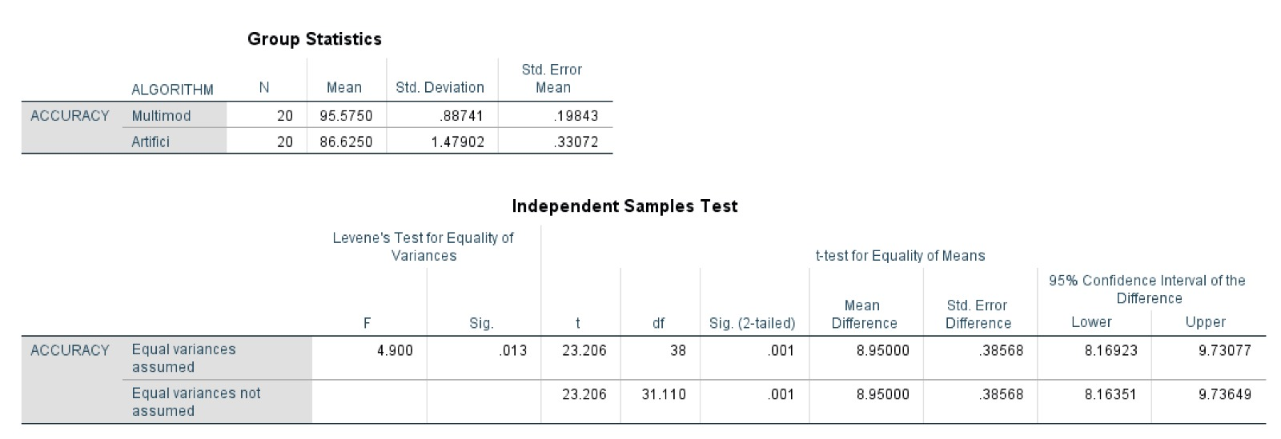
SPSS ANALYSIS
Hence it is significant since p=0.013

Slide 47
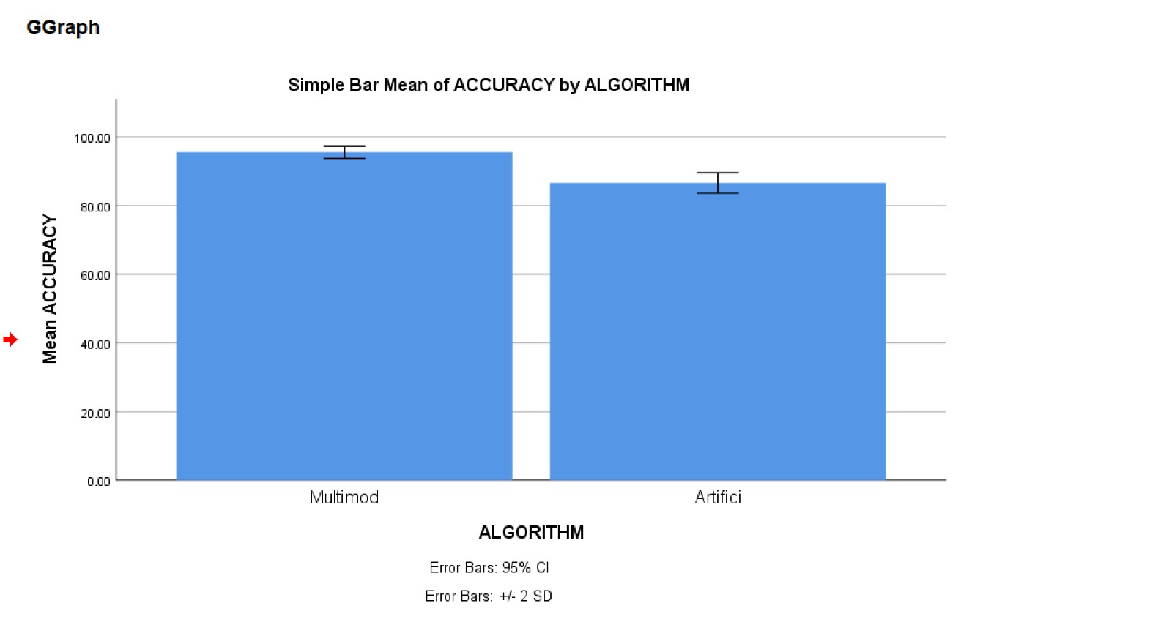
SPSS ANALYSIS

Slide 48
RESULT
The proposed approach using Multimodal AI (Multimodal Artificial Intelligence) with a mean accuracy of 95.57% demonstrates a clear improvement in deepfake detection performance compared to AI Governance-based techniques, which achieved a mean accuracy of 86.62%.
The higher mean accuracy of the proposed model indicates its superior capability in identifying fake and real content by effectively integrating multiple feature representations such as visual, audio, and temporal features.
This improvement is further supported by statistical analysis obtained from the T-test, where the significance value (p = 0.013) is less than 0.05.
Therefore, the observed enhancement in detection accuracy using Multimodal AI is statistically significant and not due to random variation, confirming that the proposed method outperforms the existing AI Governance-based techniques in deepfake detection.

